Slide 1
Summer 23 Safe Reinforcement Learning for Self-Adaptive Systems Lecture-4: Model-Based Reinforcement Learning
Prof. Dr. Holger Giese (holger.giese@hpi.uni-potsdam.de)
Christian Medeiros Adriano (christian.adriano@hpi.de) - “Chris”
He Xu (he.xu@hpi.de)
Sona.Ghahremani (sona.ghahremani@hpi.de)
Mustafa Ghani (Mustafa.Ghani@hpi.de)

Slide 2
Dyna-Q: learning a model of the environment

Slide 3
Dyna-Q: learning a model of the environment
“Thinking is acting in an imagined space” (Konrad Lorenz)
“Perception is a generative act” – Gross et al. [1999]
“Consciousness is a controlled hallucination” - Anil Seth [2000]
“The images that reach consciousness hold little resemblance with reality” - Lucia Meloni
“The world as we perceive it is our own invention “- Heinz von Furster
Notes:
[Gross et al. 1999] H.-M. Gross, A. Heinze, T. Seiler, V. Stephan, Generative character of perception: a neural architecture for sensorimotor anticipation, Neural Networks, Volume 12, Issues 7–8, 1999, Pages 1101-1129, ISSN 0893-6080,
https://doi.org/10.1016/S0893-6080(99)00047-7.

Slide 4
Motivation
Algorithms are built with the assumption that we can obtain the true model of the environment.
This might not be true in many situations:
data is non-i.i.d. (independent and identical distributed) data (auto-correlations)
environment is non-stationary (change in distributions)
multiple agents interact within the environment (interference)

Slide 5
Model-Based RL
Advantages:
Domains where learning a value function is hard, e.g., domains with large action space, like chess. The model is straightforward (2 x 2 table with deterministic outcomes of actions)
In these cases, a model is a more compact and more useful representation than a value-function or a policy
Can efficiently learn a model using supervised learning
Can reason about model uncertain
Allows the agent to look ahead. To make decisions based on what the agent believes about how the environment works.
Disadvantage:
Two sources of approximation error:
learning the model then
constructing a value function

Slide 6
Intuition-1
What is the difference between learning a reward function vs a value function (as we did in q-learning)?
Difficult scenarios for learning a value function:
Board games with an explosion of possible moves and configurations
Maze that changes after each episode
Solution:
learn a model of the environment
use that to learn the value function
Learning a model = learning the transition probabilities

Slide 7
Intuition-2
Models of the environment:
allow to retrieve state and actions that useful.
avoid costly interaction with the environment
Conversely:
Without a model we the experience that we learn is too tightly couple with the experience
Model allows to keep a level of skepticism about this experience
Example:
Sometimes we are in an area where I know nothing, so learning is very hard.
Other times we are in an area where I know everything, so I have to go far to learn something new.

Slide 8

What is a model that we can learn?
A model is a representation of the MDP <s, a, ρ_{η}> s=states, a=actions, ρ=transitions parameterized by η
Assuming that states and actions are the same as in the environment
Learn the transition function and the reward

Slide 9
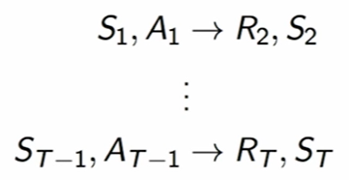

How do we learn a model from experience?
Given a stream of experiences: {S₁,A₁, R₂, … S_{T}}
It is a supervised learning problem
Learn a function that:
f(s,a) = r, s’
Example:
choose a loss function (mean-squared error)
find the parameter η for the transition function ρ_{η} that minimizes the empirical loss
Expectation model

Slide 10


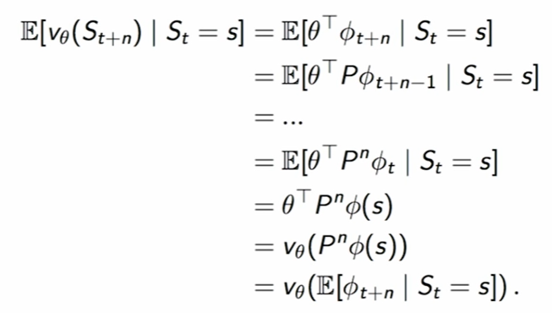
Expectation Model
Considering Linear Model
Transition matrix P
Value function V
Expectation move to inside
Caveat: Might provide states that are never achievable, which happens in non-linear models

Slide 11

Stochastic Model (Generative Models)
Instead of querying the real environment, we query our stochastic model.
Allows to sample trajectories that are plausible, in contrast with expected states.
We add a noise term ω
Caveat: Stochastic models increase variance because of the noise

Slide 12
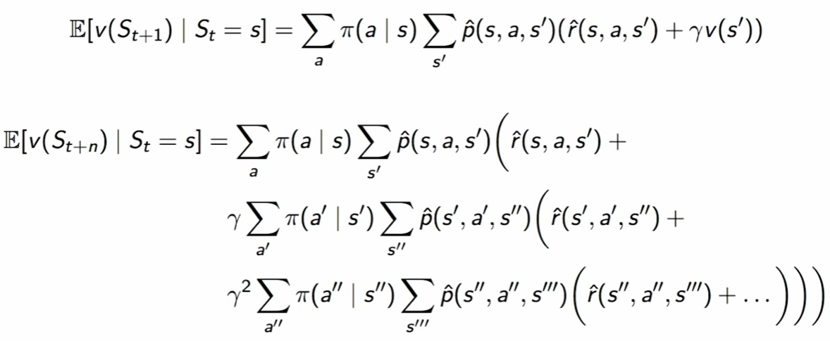
Full Models (Generative Models)
Balance bias and variance by learning the transitions and the stochasticity of the environment.
This involves branching for every state for the same action:
“For continuous state spaces, these sums will become integrals. “
Caveat: These trees also might grow very fast.

Slide 13
How to represent these learned models?
Table lookup Model
Linear Expectation Model
Linear Gaussian Model
Deep Neural Network Model

Slide 14


Table Lookup Model
It is an explicit MDP
It counts the visits N(s,a) to each state action pair
Transition function
Reward function

Slide 15

Inaccurate models
Given an imperfect model where
Performance will be limited to the optimal policy for an approximate MDP <s, a, ρ_{η}>
Hence Model-Based RL will be only as good as the estimated model
Alternative solutions:
When model is wrong, use Model-Free RL
Reason explicitly about the model uncertainty over η (e.g., Bayesian methods)
Combine model-based and model-free in a safe way

Slide 16


Real versus Simulated Experiences
Real experience is sampled from the environment (true MDP)
Simulated experience is sampled from our model (approximate MDP)

Slide 17
Road so far
Model-Free RL
No Model
Learn Value function of Policy from Experience
Model-Based RL
Learn a model from the experience or be given a Model
Plan Value function or Policy from Model
Dyna Architecture
Learn a Model from the experience
Learn and Plan Value function or Policy from real and simulated experience
Treat real and simulated experiences equivalently
Updates from learning and planning are not distinguished
Notes:
When an agent has a model of the environment, the border between the agent and the environment becomes more difficult to determine.

Slide 18
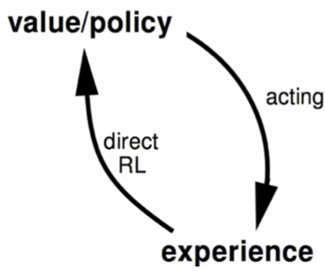
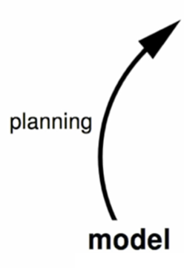
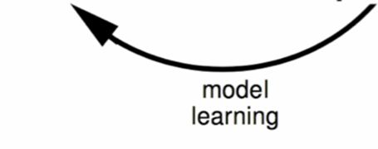
Dyna Architecture
?
?
New observation from the environment
OR
Reuse previous observations (experience replay)
?
Notes:
Local decisions per shop, Global decisions across shops
Failure propagation as a sub-model of the transitions
Check the impact of failures on same component type happening in different shops.
Clarify what the model is with respect to the decision model and the state model
Difference frequencies of execution of each loop. How to determine when to execute each loop?
Lowe level loop abstracts the environment.
Not every monitoring is an experience that we can use for learning.
Features are graph queries, hence feature discovery map to evaluating graph queries.
Examples of how these architectures would look like.
Utility change prediction (which we did in the past) could be done in an online context.

Slide 19
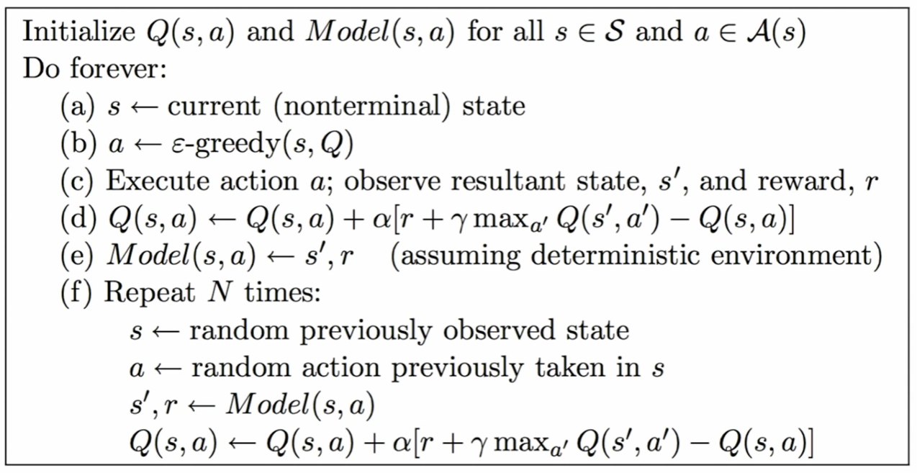
Dyna pseudo-code
Python code example: https://github.com/andrecianflone/dynaq/blob/master/dynaq.py

Slide 20
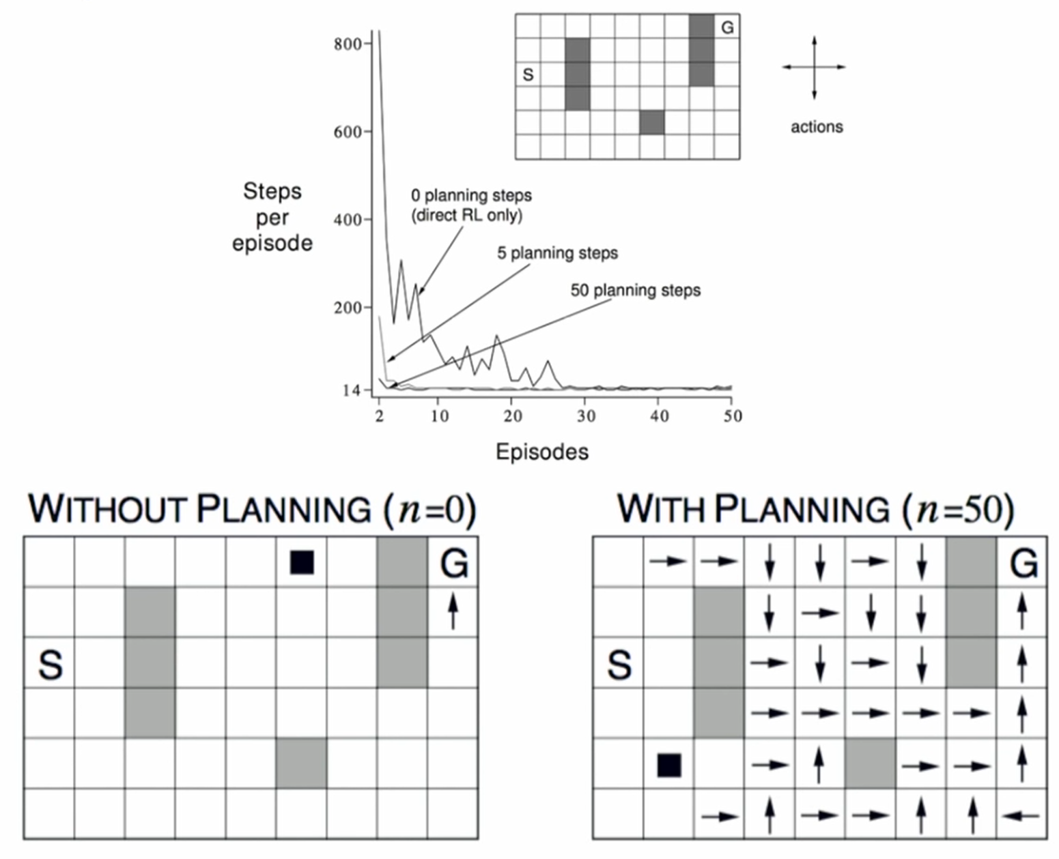
Dyna Q with a Maze example

Slide 21
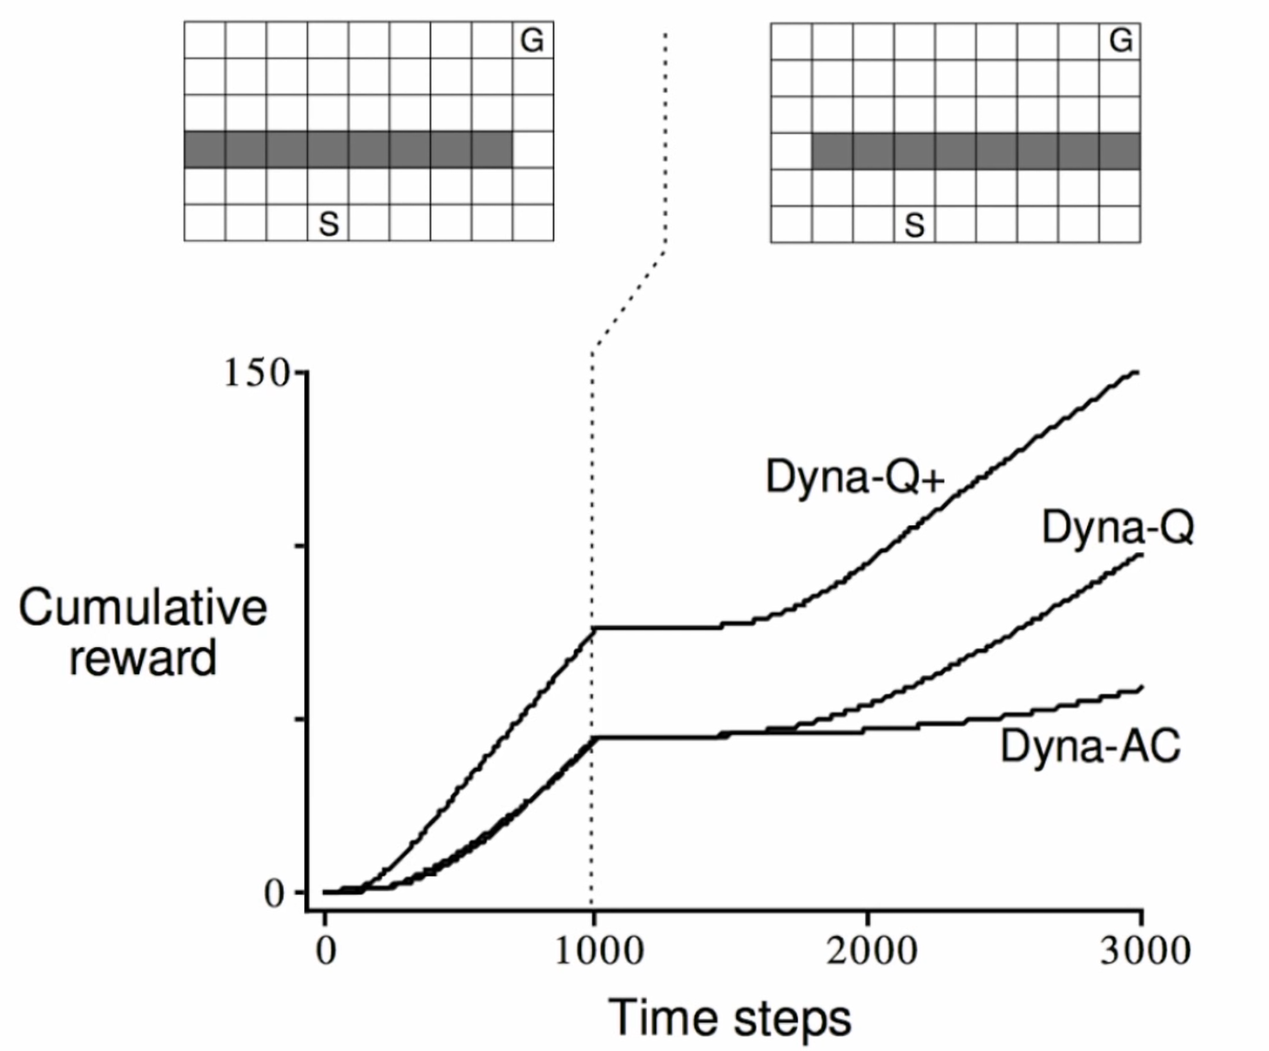
Dyna-Q with inaccurate model
Model changed! Became harder to attain the goal
Dyna-Q+ is Dyna-Q with an exploration bonus that encourages exploration
Dyna-AC is a Dyna-Q that uses an actor-critic learning method instead of Q-learning

Slide 22
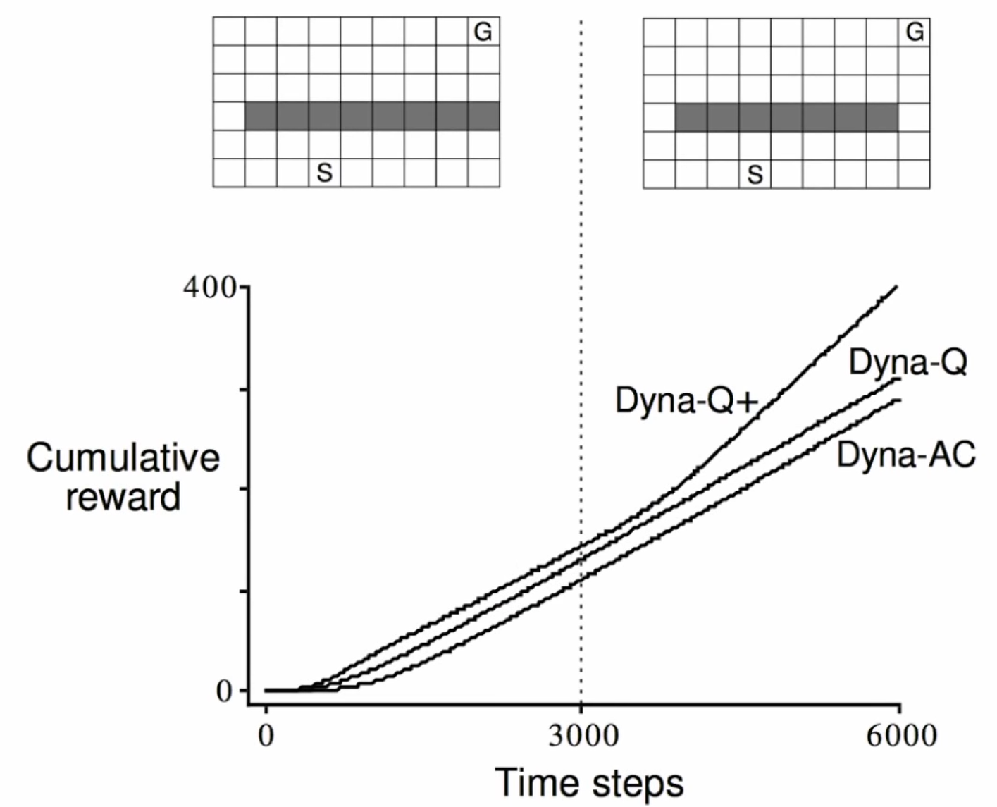
Dyna-Q with easier inaccurate model
Model changed! Became easier to attain the goal

Slide 23
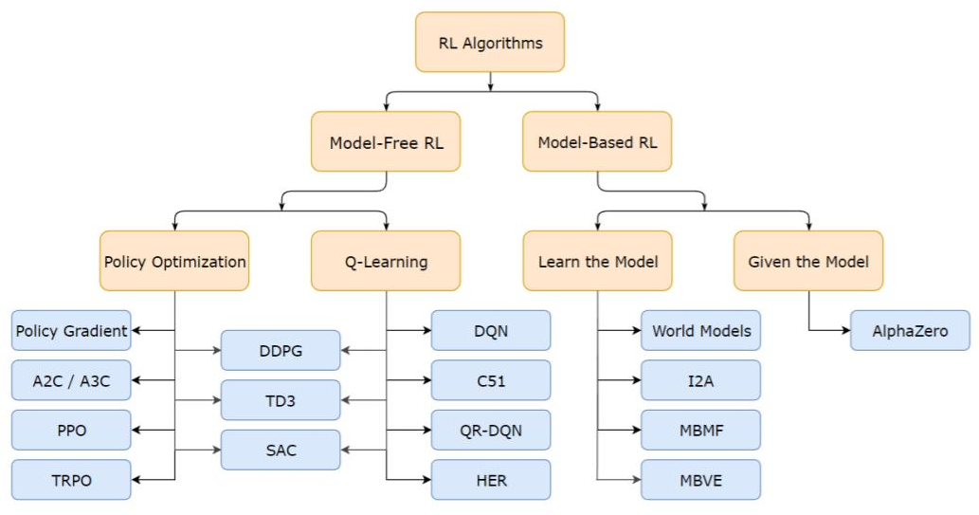
Brief Taxonomy of RL Methods

Slide 24
More interesting topics
Actor-Critic Model
Batch Reinforcement Learning
Hierarchical Reinforcement Learning
Bayesian Reinforcement Learning
Working with non-stationary environments
Reinforcement Learning for Optimizing Hyperparameters
Hidden Markov Models
Partially Observable Markov Decision Processes
….

Slide 25
Interesting lectures
David Silver, 2015, University College London Lecture 1 https://www.youtube.com/watch?v=2pWv7GOvuf0 Lecture 2 https://www.youtube.com/watch?v=lfHX2hHRMVQ&list=PLqYmG7hTraZDM-OYHWgPebj2MfCFzFObQ&index=2&pbjreload=10 Lecture 3 https://www.youtube.com/watch?v=Nd1-UUMVfz4&list=PLqYmG7hTraZDM-OYHWgPebj2MfCFzFObQ&index=3&pbjreload=10 Course website: https://www.davidsilver.uk/teaching/ | Bottom-up explanations based on introducing the simpler models before adding the complexity that justify more complex models. Explains the math behind concepts.
Pascal Poupert, 2018, University of Waterloo, Canada Lecture 1b: https://www.youtube.com/watch?v=yOWBb0mqENw&list=PLdAoL1zKcqTXFJniO3Tqqn6xMBBL07EDc&index=2&pbjreload=10 Lecture 2a: https://www.youtube.com/watch?v=yOWBb0mqENw&list=PLdAoL1zKcqTXFJniO3Tqqn6xMBBL07EDc&index=2&pbjreload=10 Lecture 2b: https://www.youtube.com/watch?v=mjyrRG7RD84&list=PLdAoL1zKcqTXFJniO3Tqqn6xMBBL07EDc&index=5&pbjreload=10 Course website: https://cs.uwaterloo.ca/~ppoupart/teaching/cs885-spring20/schedule.html | More conceptual level with examples of applications.
Charles Isbell & Michael Littman, 2015, Georgia Tech https://www.youtube.com/watch?v=rETmf4NnlPM&list=PL__ycckD1ec_yNMjDl-Lq4-1ZqHcXqgm7&index=128&pbjreload=10 | Step-by-step explanations with fun discussions and lot of small examples to illustrate each core MDP principle
Nando Freitas, 2015, Lectures Oxford University, UK Lecture 15 https://www.youtube.com/watch?v=kUiR0RLmGCo Lecture 16 https://www.youtube.com/watch?v=dV80NAlEins Course Website: https://www.cs.ox.ac.uk/people/nando.defreitas/machinelearning/ | Lectures in the context of Deep Learning, but still provide the necessary concepts of RL.

